Slide 1
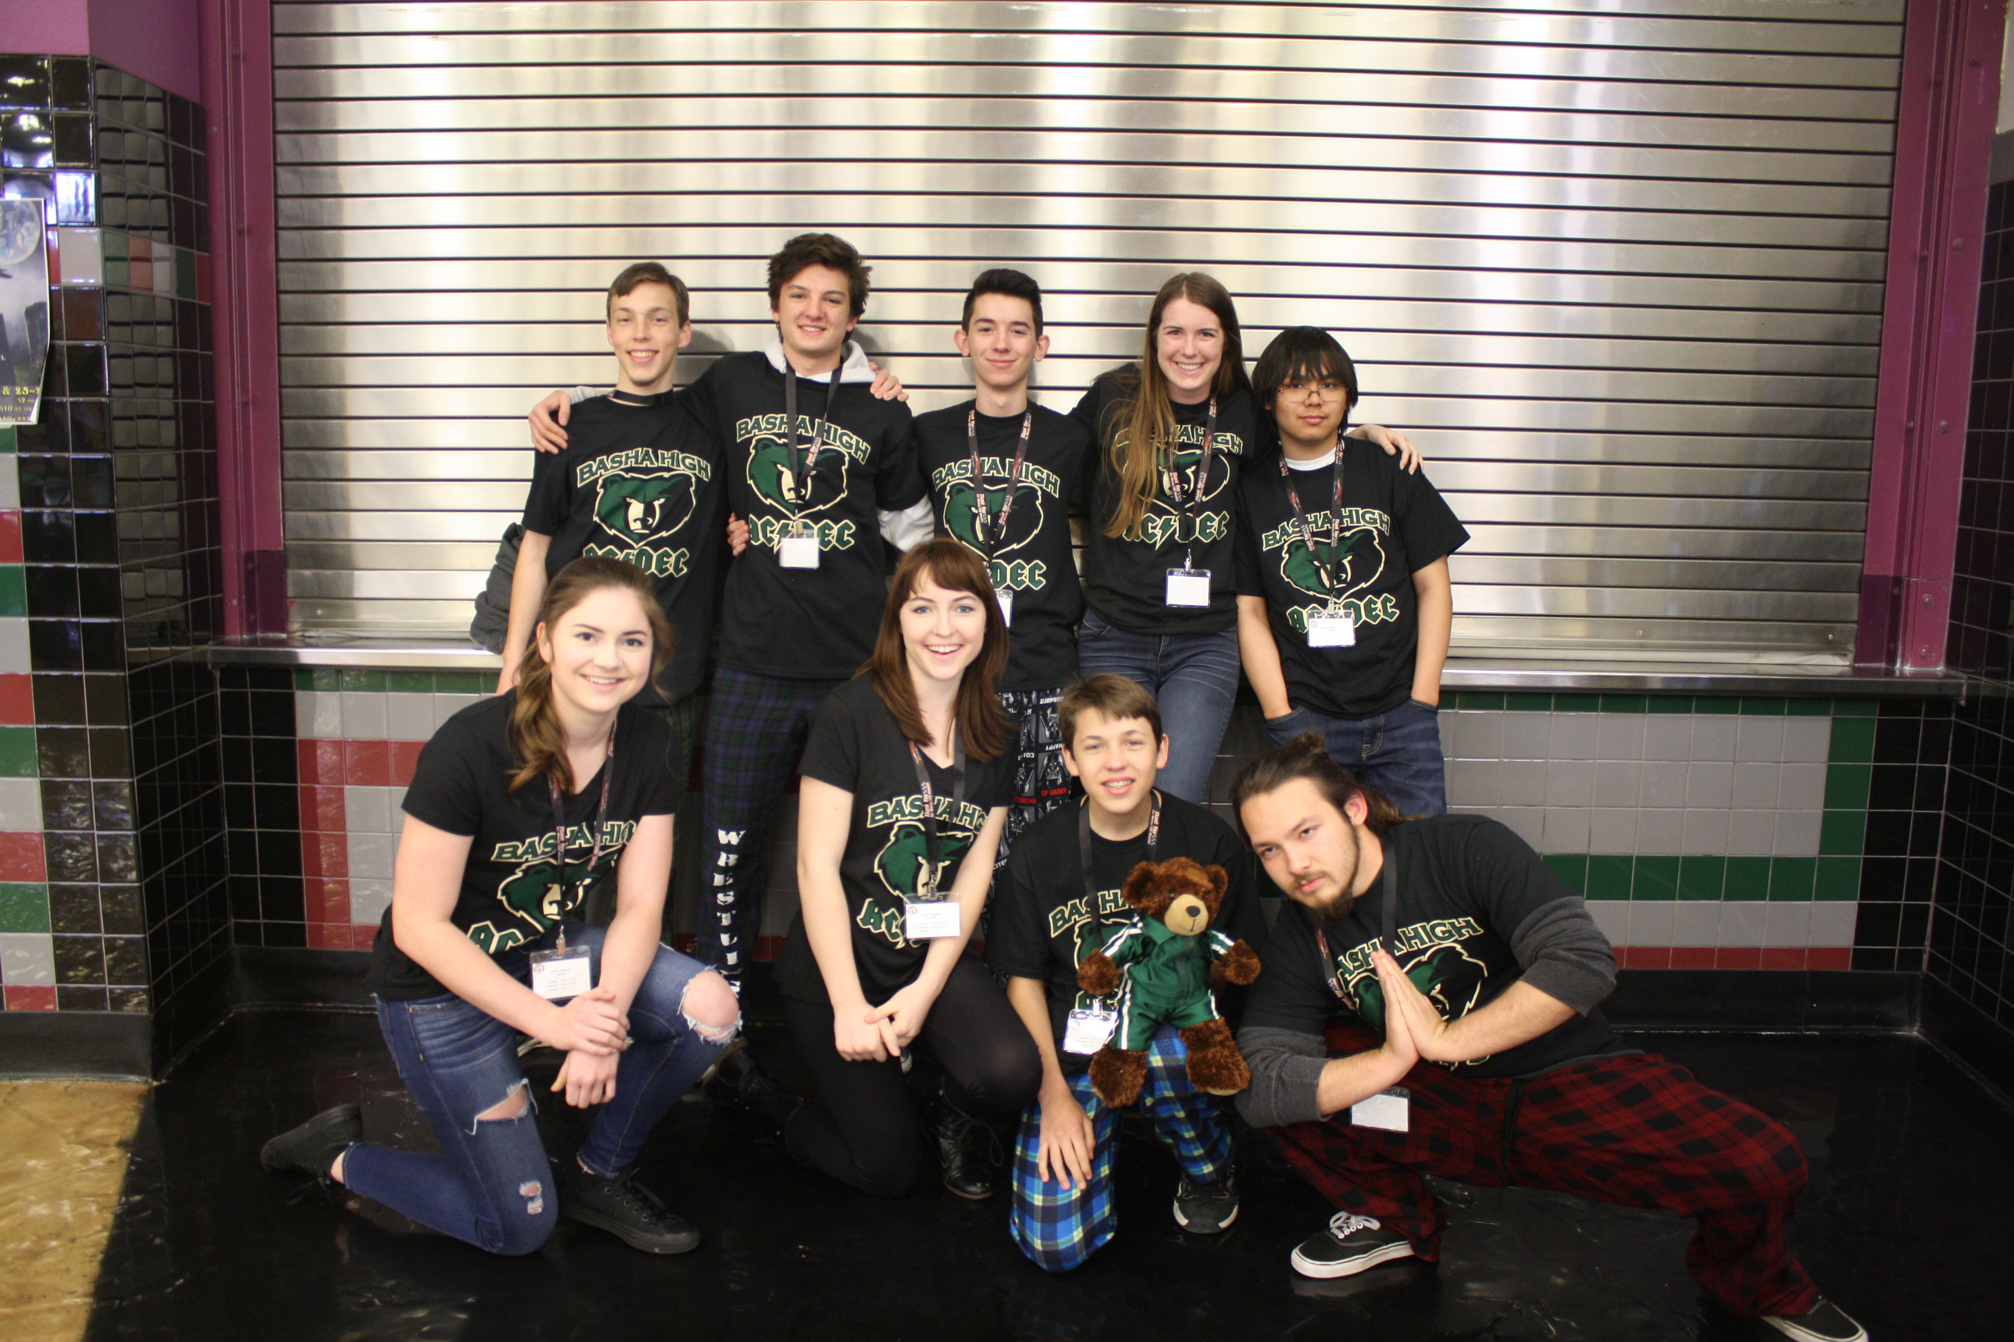
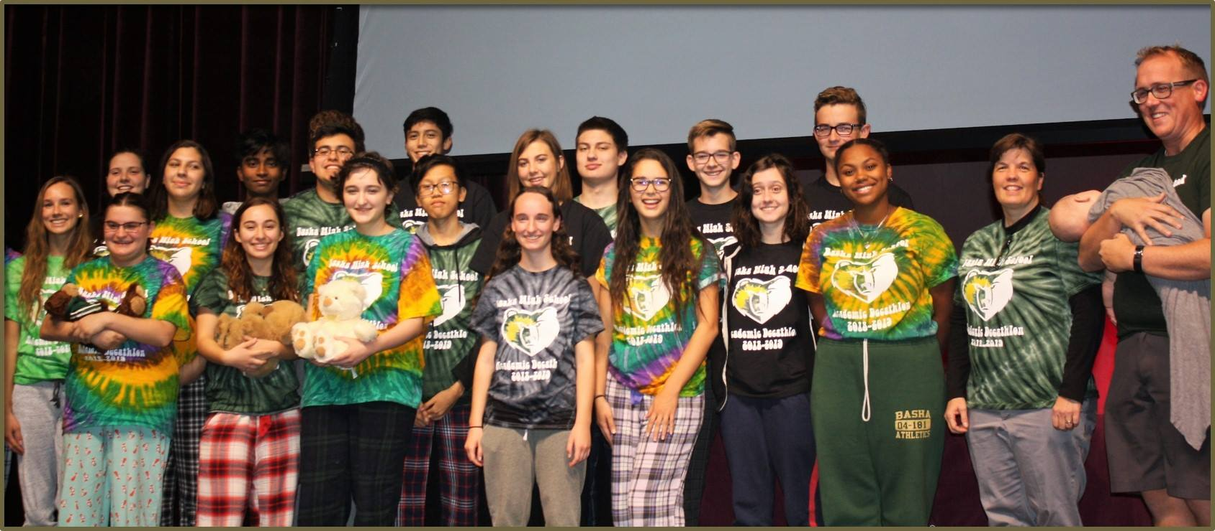
Basha High School Academic
Decathlon
Class and Team

Slide 2
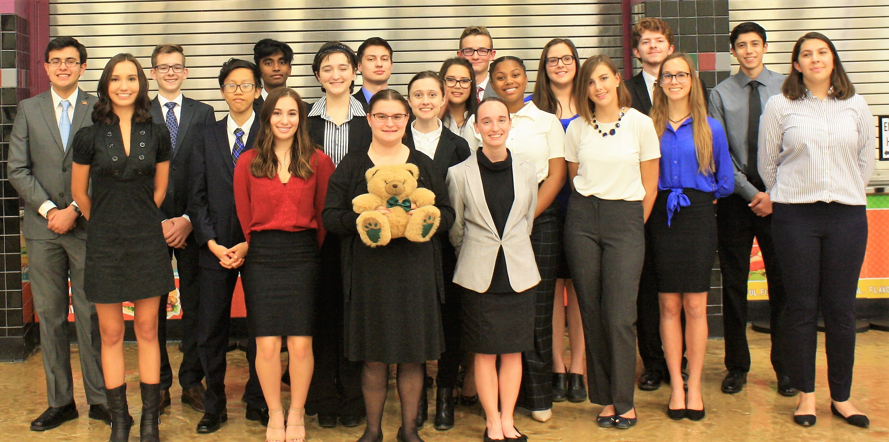
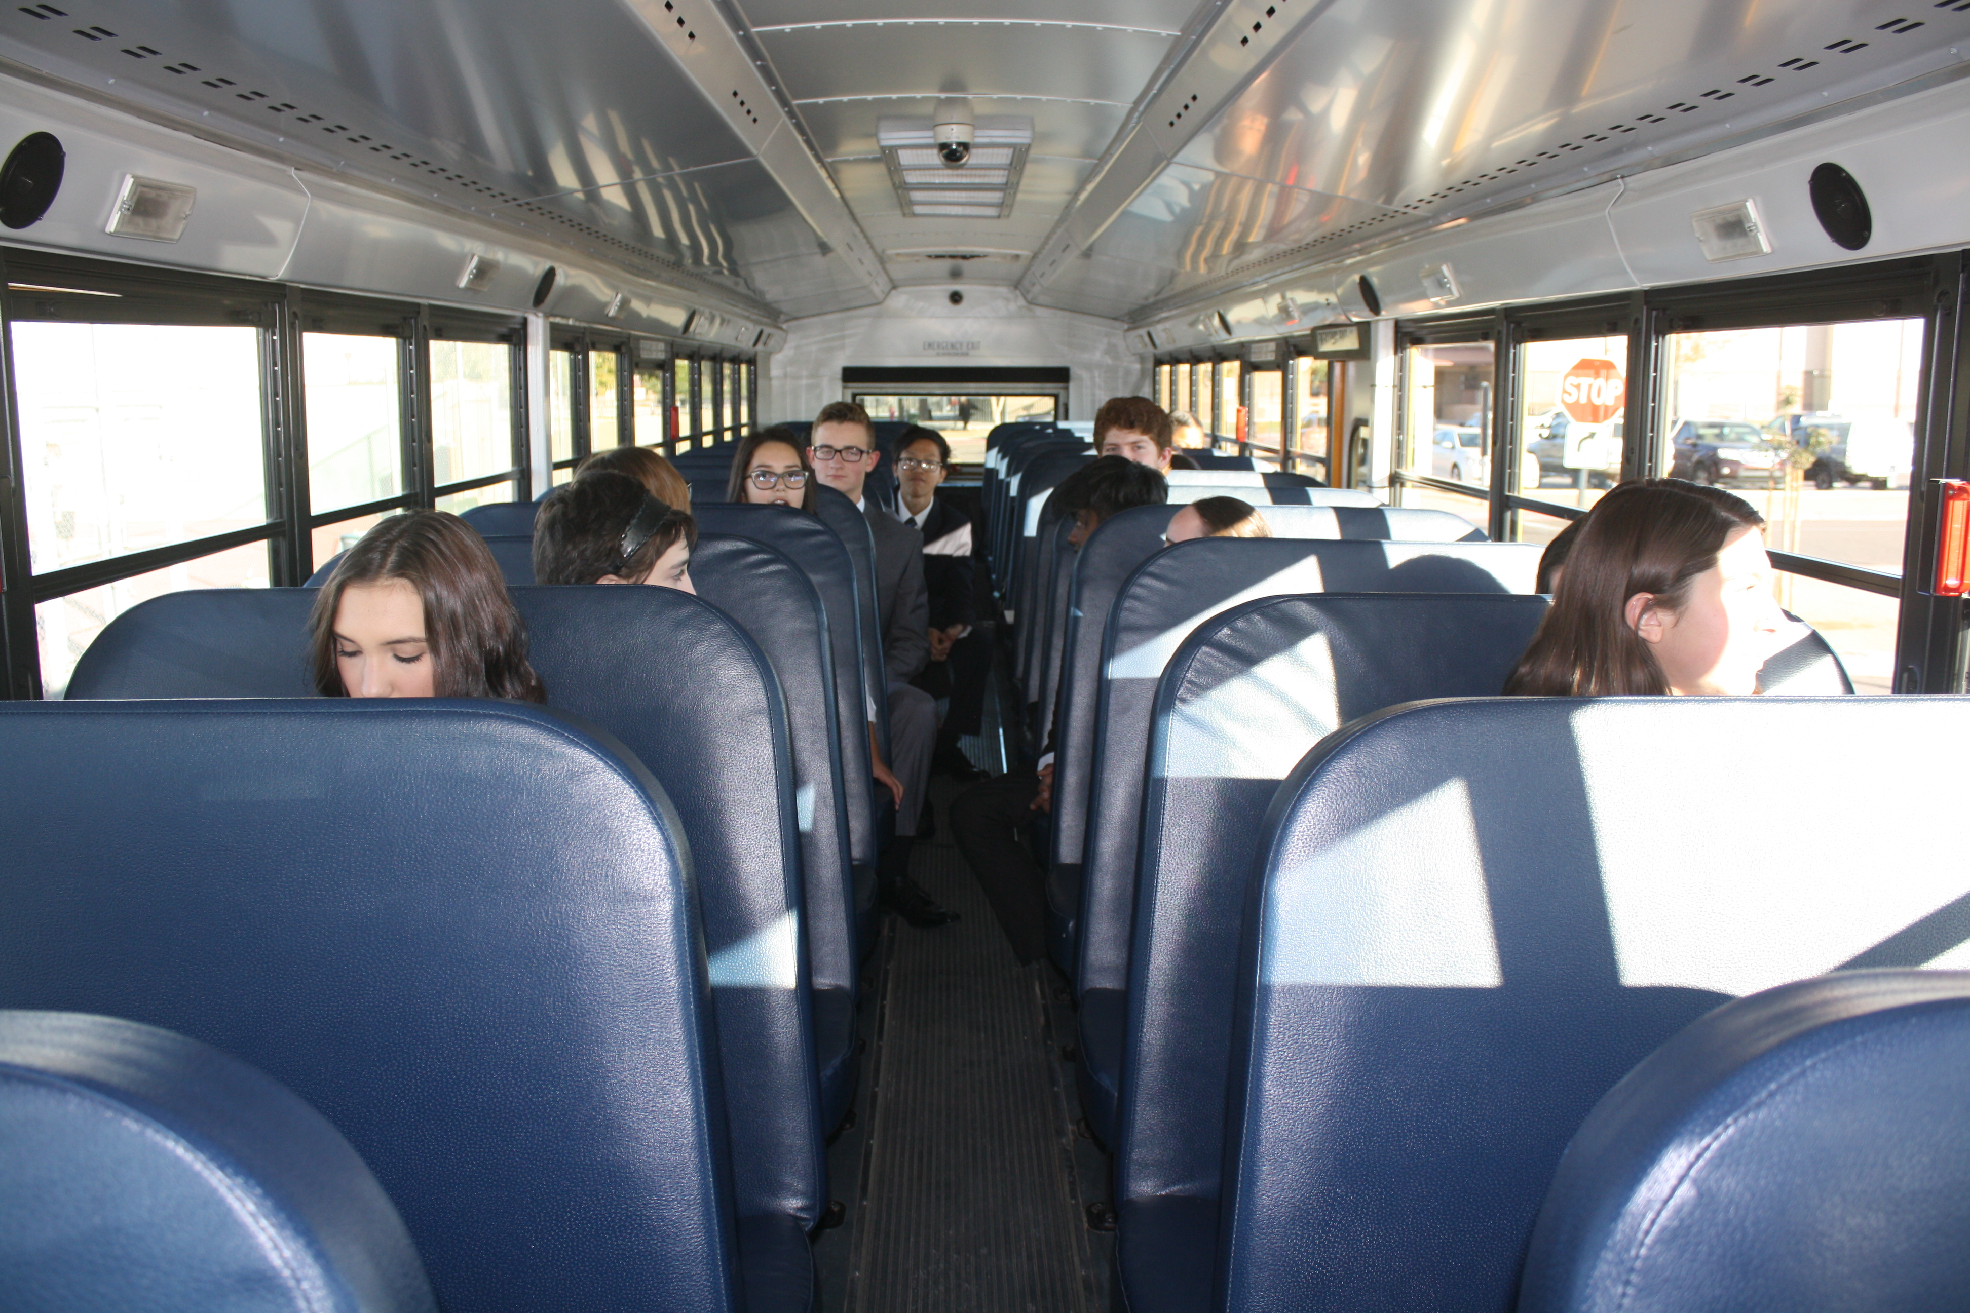
What do we do?
Class:
English Elective
Weighted Elective Grade improves GPA
Honors Academic Decathlon
Tournaments
Invitationals, Regional, State & National Tournaments

Slide 3
Scope
An overall Curricular Theme is given each year that integrates the different academic disciplines.
2018-2019: The 1960’s, Transformational Decade
2017-2018: Africa
2016-2017: World War II
2015-2016: India
2014-2015: New Alternatives in Energy
2019-2020: Health And Wellness
2020-2021: The Cold War
2021-2022: Water A Most Essential Resource

Slide 4
Full AcDecTeam =
Varsity
Scholastic
Honors
Varsity
3.19↓
Scholastic
3.2-3.79 GPA
Honors
3.8-4.0 GPA
Only the four core subjects and world language grades from the students’ previous two year’s transcript are used to calculate GPA weights; not current grades or any electives such as PE or Music or CTE.
A team can only win with at least 2 teammates in all three weight divisions. A full team consists of 3 honors, 3 scholastic and 3 varsity students.
All students in the class will participate at invitationals. All students can win individual medals whether they are one of the nine students on the “A” team or not. Some students specialize in a specific subject (for example math, music, speech) but all must compete in all 10 areas and are encouraged and coached to improve in all 10 disciplines. The top 3 overall scores (1000 x 10=10,000 total points) in each of the three GPA divisions will advance to Regional and State competitions as the official school team.
This provides an opportunity for students who are academically interested, but for some reason, have some B or C grades to succeed. It also shows the students at a young age that grades are not necessarily an indicator of intelligence and that they should strive to work with students at all levels. Students also experience that often the person with the highest GPA is not necessarily the smartest person in the room. I have been pleasantly surprised at how some of our "C" students have scored higher than many of the "A" students. This develops a tolerance for different talents in peers and a greater ability for collaboration.

Slide 5
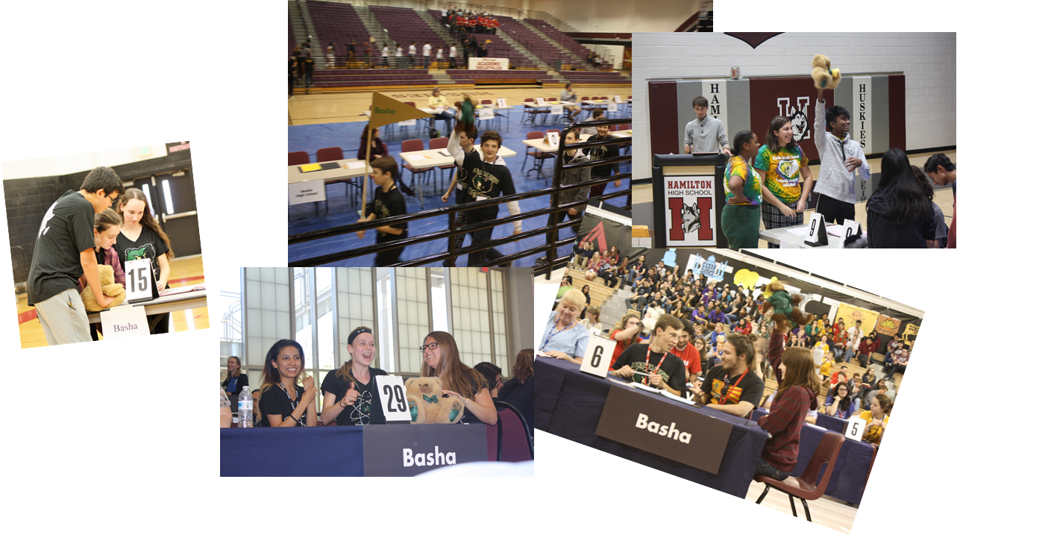
Decathlon = 10 Events + Super Quiz (SQ is open to the public to watch)
Super Quiz

Slide 6
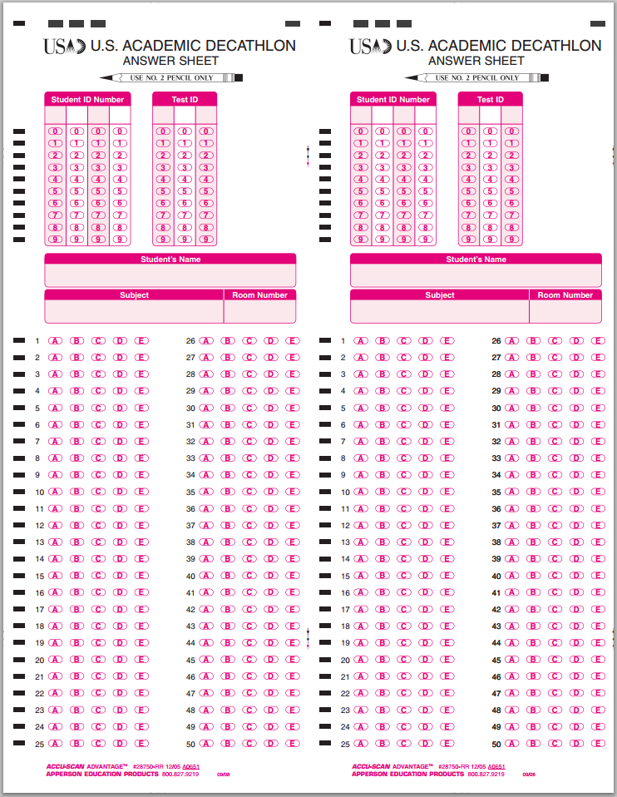
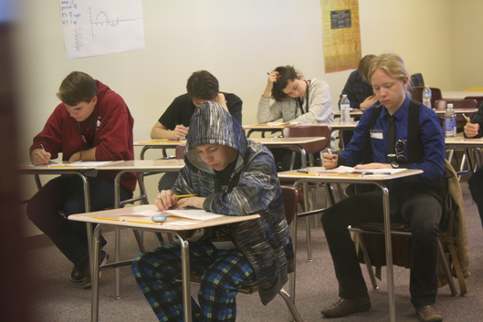
Decathlon = 10 Events 1000 pts each
Science
Literature
Art
Music
Social Science
Economics
Mathematics
7 objective events (tests)
Tests

Slide 7
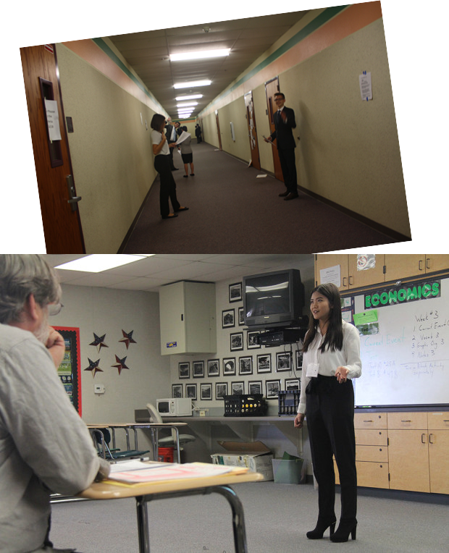
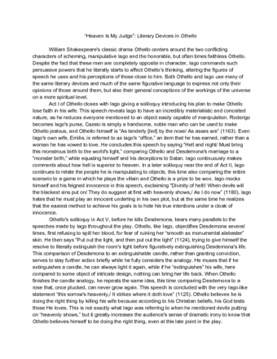
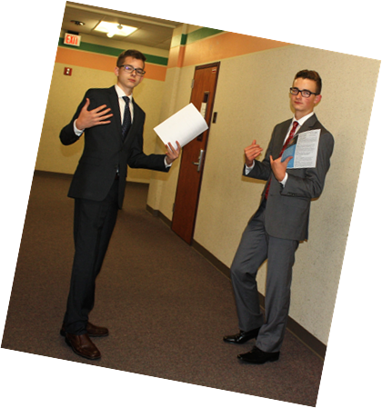
Decathlon = 10 Events
3 Subjective events (performance events)
8. Essay
9. Speech
10. Interview

Slide 8
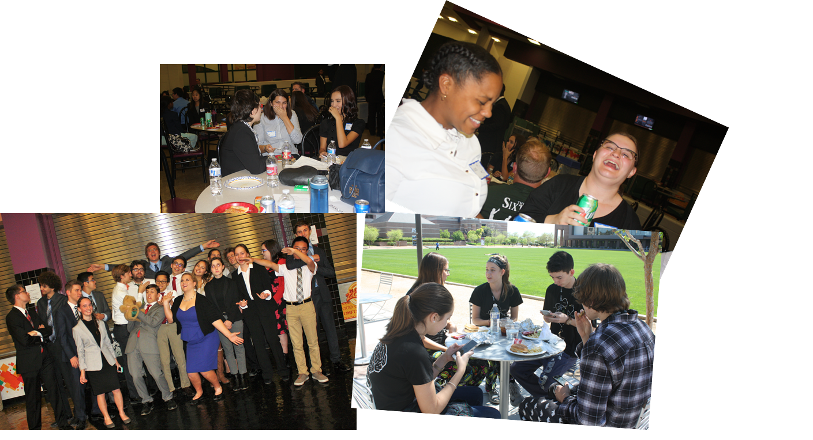
FUN – FRIENDS – FOOD

Slide 9
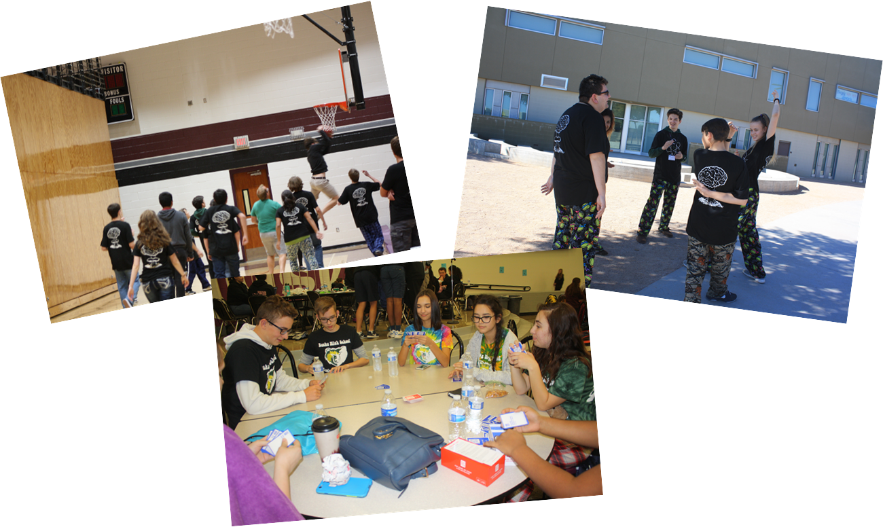
Play a little to let of the pressure.

Slide 10
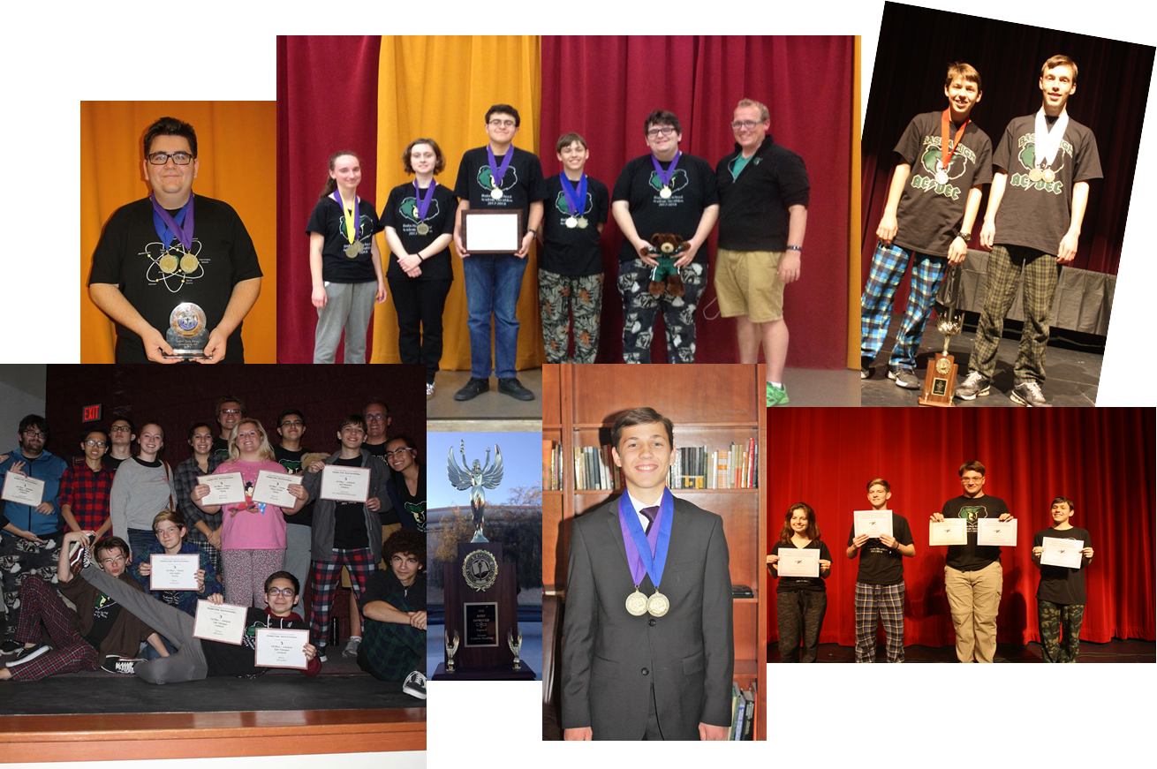
Awards
Awards Ceremonies are open to the public to watch.
We invite all parents and families to be present for awards.

Slide 11
Scholarships
Arizona Academic Decathlon Association grants cash prizes and post-secondary scholarships for top-scoring decathletes and members of winning teams.
University Scholarships for Decathletes
The major Arizona universities have recently offered the following scholarships. For all of the scholarships listed below except the ASU Two-Year Participation Scholarship, Arizona Academic Decathlon Association notifies the universities of the winning decathletes each year, and the universities contact the students to confirm the award. Award of these scholarships is dependent upon student eligibility and are subject to change at any time.
Arizona State University
ASU Scholarships of $2,000 renewable for three years ($8,000 total if used for four years) are offered to the nine team members of the first place regional teams.
ASU awards $2,000 renewable scholarships for three years to Top Scoring Students of each region who were not members of the winning teams. These are the students who are awarded the ten-event medal.
ASU Two-Year Participation Scholarship is a one-time $500 cash award to any student who has been part of a competing team for two years. Students must apply to receive this scholarship; application information is available here.
University of Arizona
UA Scholarships of $3,000 renewable for three years ($12,000 total if used for four years) are offered to the nine team members of the first place regional teams.
UA awards $3,000 renewable scholarships for three years to Top Scoring Students of each region who were not members of the winning teams. These are the students who are awarded the ten-event medal.
Northern Arizona University
NAU Scholarship awards $1,750 renewable for three years ($7,000 for four years) to the nine team members of the first place regional teams.
NAU Scholarship awards $1,750 renewable for three years ($7,000 for four years) to Top Scoring Students of each region. These are the students who are awarded the ten-event medal.
http://www.azacadec.org/decathletes/scholarships/#1454963082128-2259717e-3c00

Slide 12
3 Categories
Honors
3.8-4.0 GPA
Scholastic
3.2-3.79 GPA
Varsity
3.19
How do I know which category I am in?
1. Go to your Infinite Campus.
2. Find your Unofficial Transcript.
3. Take ONLY your last 2 years semester grades from ONLY English, Social Studies, Math and Science. NO ELECTIVES COUNT,
Unless they are in the core categories).
4. Unweight them!!!
A= 4 B=3 C=2 D=1 F=0
5. Average them (add all together and divide by number of classes)

